Slide 1
Let's Travel!
Brent Shafer, Jacob Longo, Brandon Holmes, and Justin Yee

Slide 2
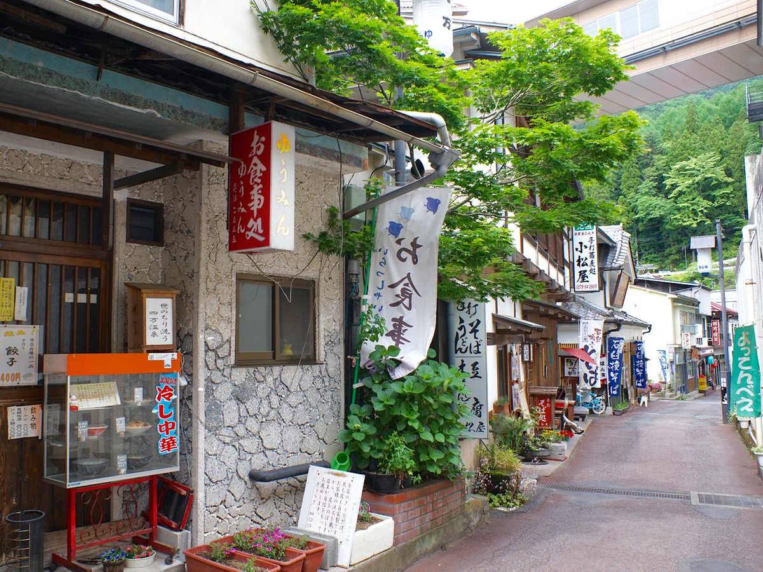
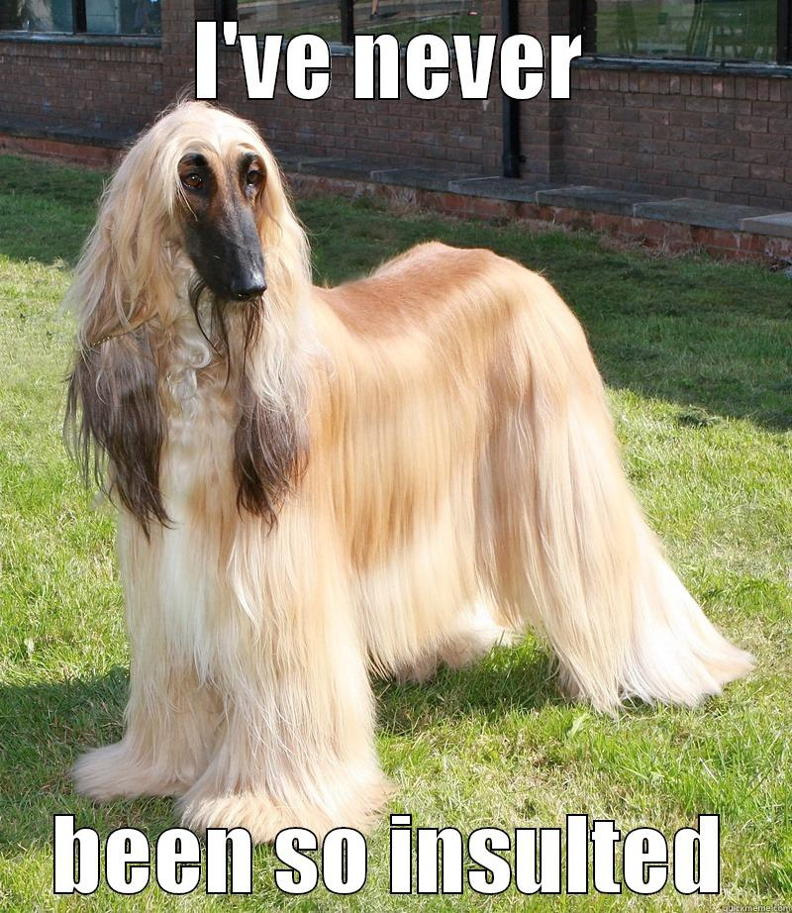
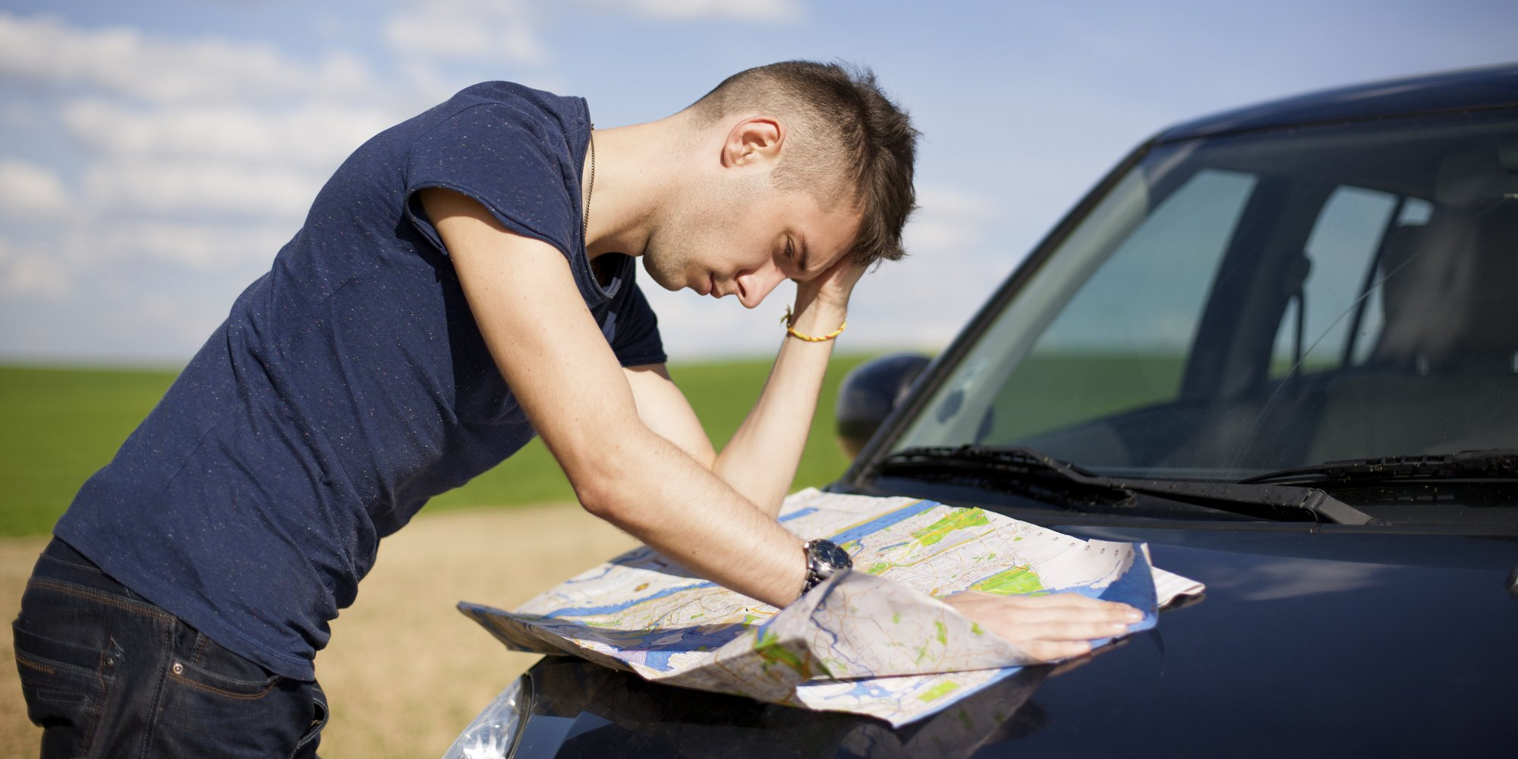
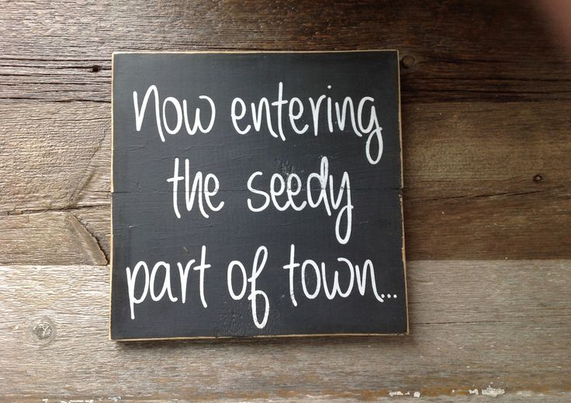
Travelling Problems
?
Not knowing customs of country
Losing a business deal
Insulting a local unknowingly
Not knowing the currency exchange
Overpay on goods and services
Not knowing the bad areas of a region
Avoid areas likely to get mugged
Solo travelers need to stay safe
Not speaking the language
Lost for hours
Rural Japan is unlikely to have English on the signs.
Finding Points of Interest
Could skip over areas of interest
Find yourself stuck in tourist trap
Finding Local Transportation
Ensure you can get around the country
Affordability
Finding a nice but cheap place to stay
Finding a good deal on flights/trains/etc.
?
?
1*
?
?
2*
4*
3*
1.URL:http://www.quickmeme.com/img/87/870dc6df2a45f79c6a8ab45f503e8727efe47d9e728433ec3974496408aad5f6.jpg
2.URL:https://www.kashiwaya.org/e/magazine/wp-content/uploads/2015/07/DSC03583-1.jpg
3.URL:https://external-content.duckduckgo.com/iu/?u=https%3A%2F%2Fi.pinimg.com%2F736x%2F57%2F8b%2F83%2F578b8363ead3a4268752e72cea0014b2--garden-signs.jpg
4.http://i.huffpost.com/gen/1909206/images/o-CONFUSED-MAP-facebook.jpg

Slide 3
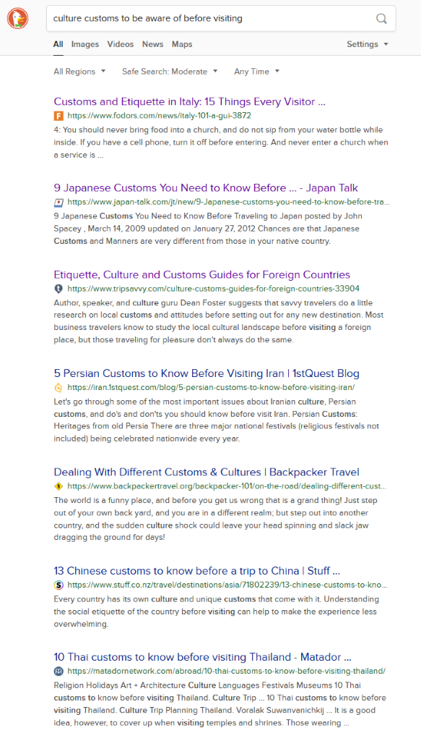
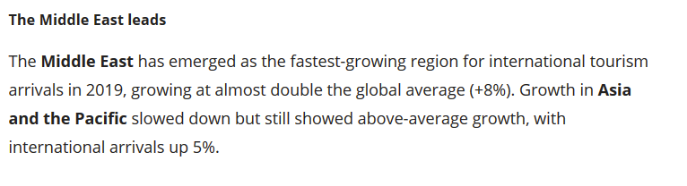
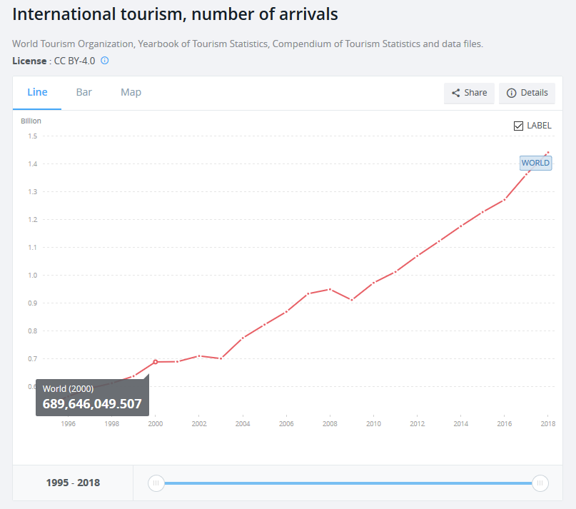
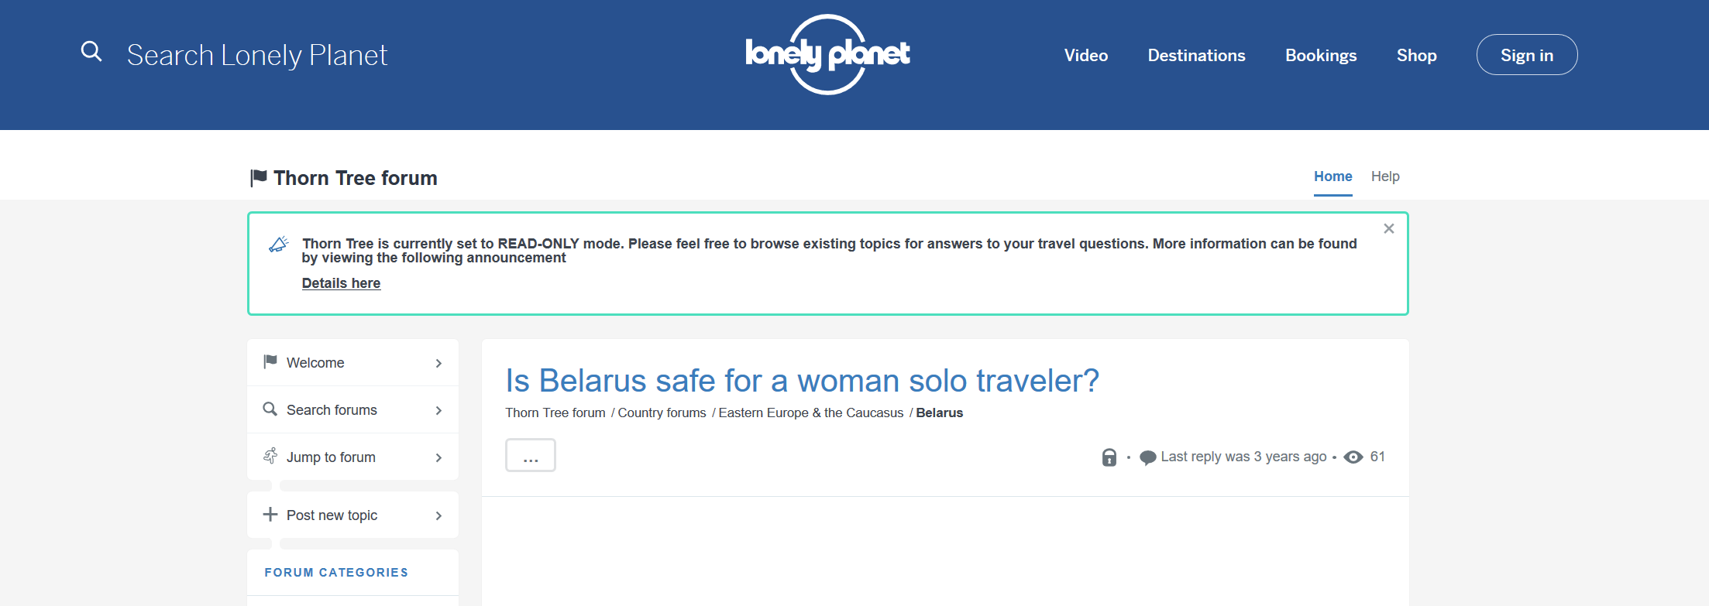
Evidence
http://www.unwto.org/international-tourism-growth-continues-to-outpace-the-economy
IMAGEURL:https://data.worldbank.org/indicator/ST.INT.ARVL

Slide 4
Existing Systems
TripAdvisor & Lonely Planet
Bulky way to navigate
Cannot find your question quickly
Anecdotal evidence from users
Not all in one
Airbnb
Trivago
Google Flights
Google Translate
Yelp
Expedia.

Slide 5
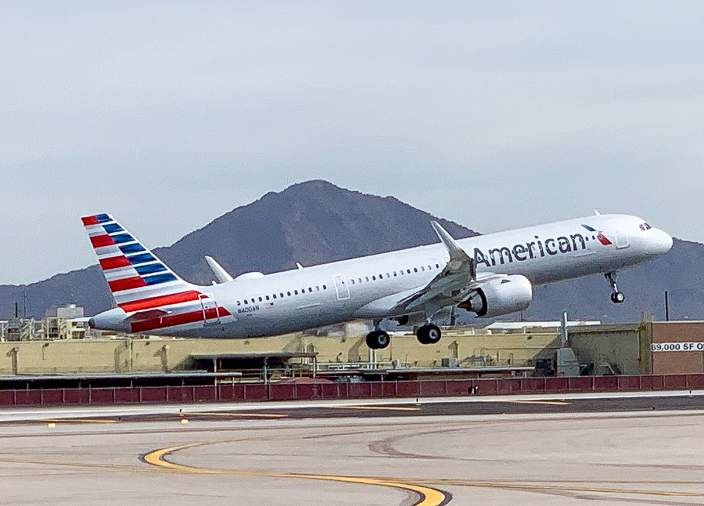
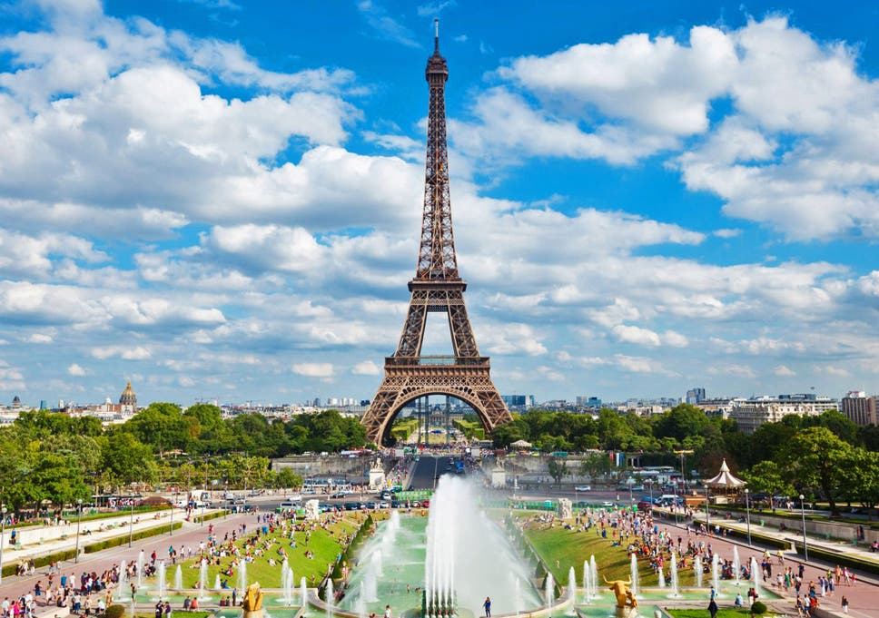
App Overview
Chosen Destination
Safety
Common Scams
Dangerous Areas
Points of Interest
Attractions
Restaurants
Landmarks
Cultural Do’s & Don’ts
Currency Converter
Language
Common Phrases
Translate

